Slide 1

Overthewire – natas 0-5
Write up by Chanan shenker

Slide 2
info:
Overthewire.org is a fun website that has a bunch of cyber security challenges that the answer to the level you solved is the key to access the next level.
This write up is the soloutions to the first 5 level of ‘natas’ which is a web application challenge.
We start with the first link that the access is the username ‘natas0’ and the password ‘natas0’.
With that said lets jump in!

Slide 3
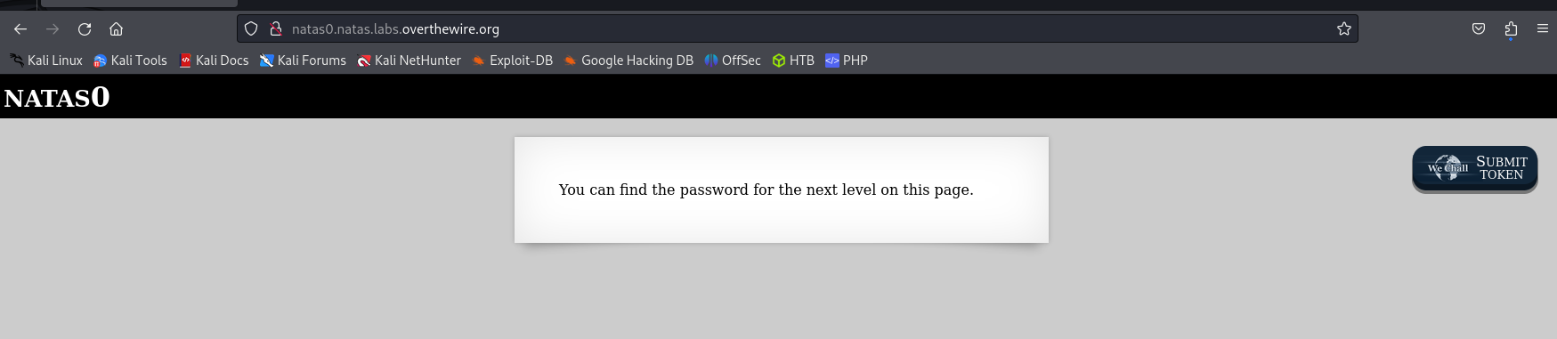
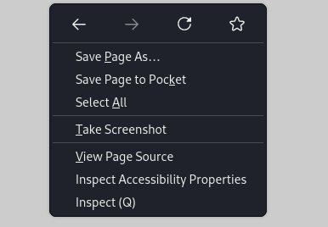
Natas0:
The first answer is pretty simple. When right clicking on a page we can click on view source page to see the code that is run to display the webpage we see in front of us.

Slide 4
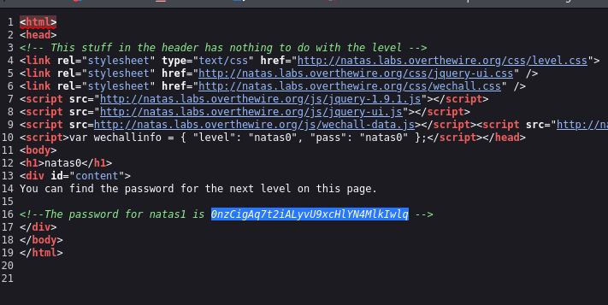
And there we solve natas0 by getting the password to natas1, so lets hope on to the natas1.

Slide 5
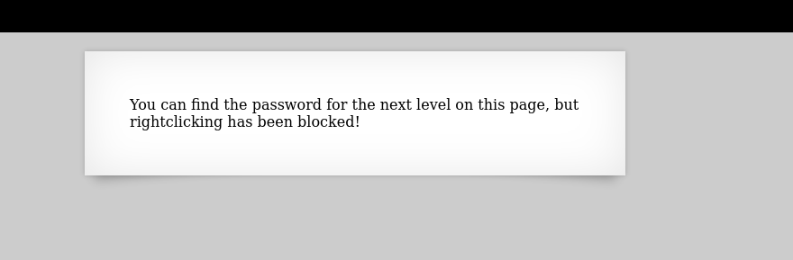
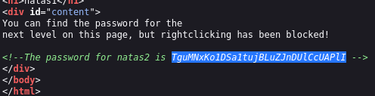
Natas1:
Here we see that right clicking is disabled but there are other ways of getting to the source code, such as hitting ctrl + U
And there we see the password to natas2.
Onwards!

Slide 6
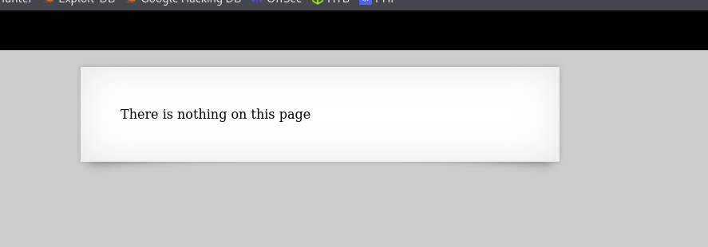
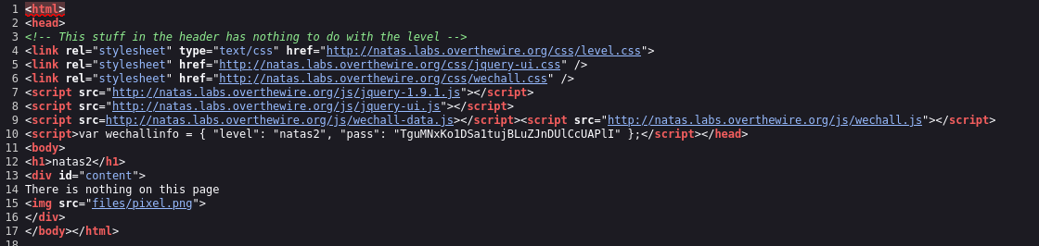
Natas2:
Here when we look at source code we don’t get the answer immediately. But we do see an interesting path. Files/pixel.png
Lets check it out.

Slide 7

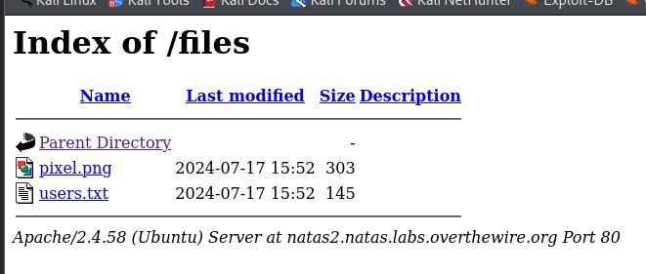
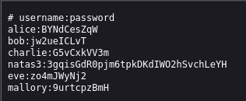
So I added the path to the url and found the files directory, in it we see a file named users.txt.
When we open it we see the password for natas3.

Slide 8
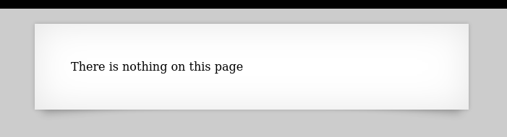
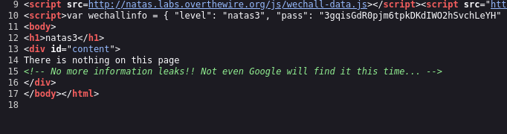
Natas3:
When we look at the source code we get a nice clue.
Robots.txt is a file that web applications can use to block users form searching certain paths that are on the web app by writing them down in the robots.txt file, google will then not index them according to the file.

Slide 9


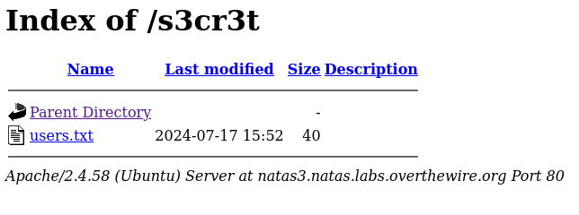

So we go to the robots.txt file and we see only one directory that is not indexed.
A quick look and we find the password for natas4.

Slide 10
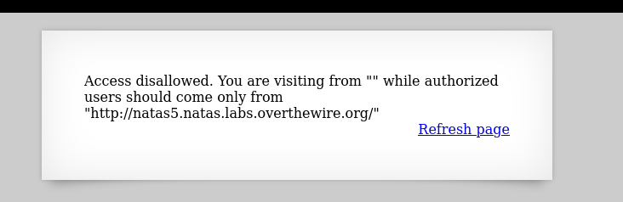
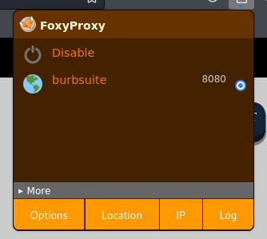
Natas4:
Here we are told that we are unauthorized to enter from the url of natas4.
So lets fire up burp suite and seewhat the request looks like.
“foxyproxy” is a personal favorite when working with burp suite. Since burp suite intercepts traffic through a proxy, ‘foxyproxy’ can make it easy to jump from using burb suite to accessing other site.

Slide 11
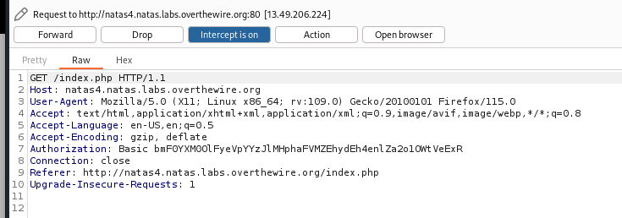

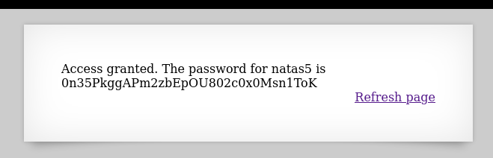
I captured the request.
Note at the bottom of the request is the referer, that currently has the natas4 url.
So lets edit it. I erase it and put the natas5 url from the page to see if it lets us in.
Viola!

Slide 12
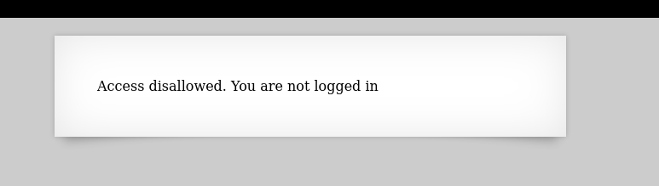
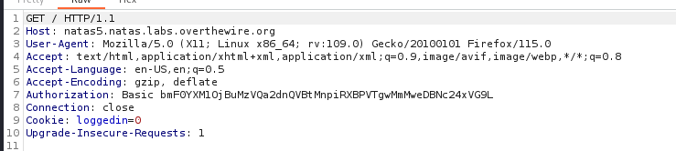

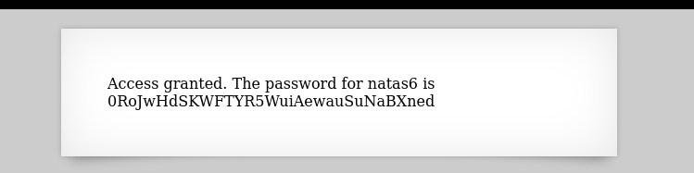
Natas5:
For natas5 we are told that we are not logged in. so lets capture another request and see what's there.
At the bottom we see the cookie has a ‘loggedin=0’, since its 0 it probably means false, like Boolean numbers 0=false 1=true.
So lets change that to true. I edit the 0 to be a 1 and send the request over.
And there we go!

